Slide 1
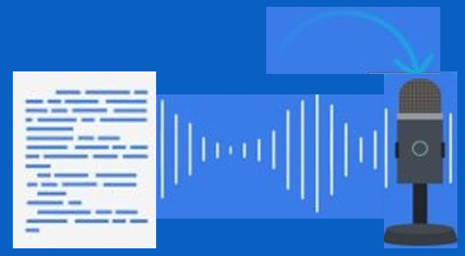

Text to Speech​

Slide 2
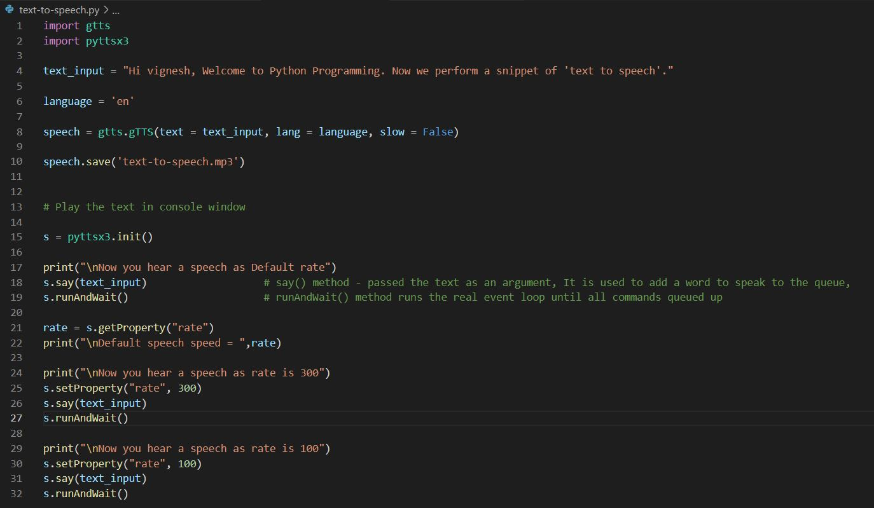
Python Snippet
Install gtts in Python <pip install gTTS>
--> For converting text to speech
2. Install pyttsx3 Python <pip install pyttsx3 >
--> For playing speech in output window

Slide 3
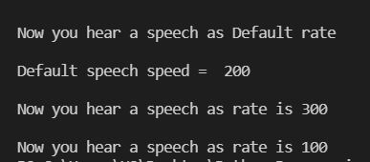

Output
Terminal window
Audi file : text-to-speech.mp3

